Slide 1
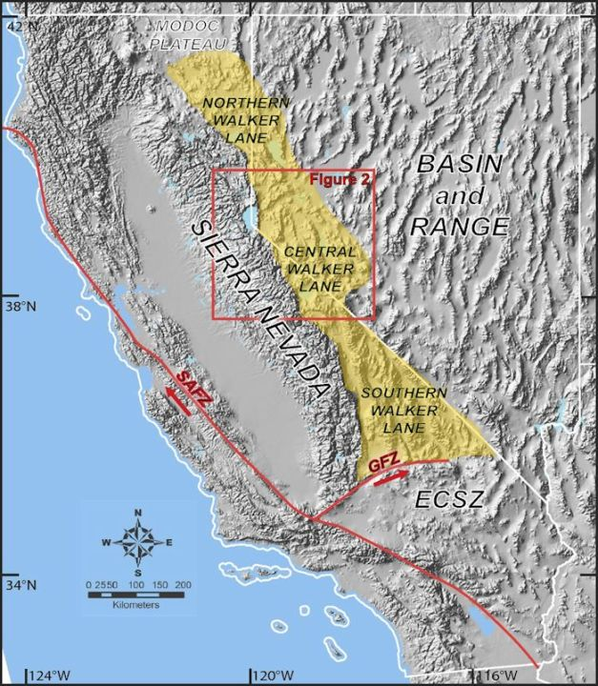
Late Cenozoic extensional transfer in the Walker Lane strike-slip belt, Nevada
Oldow 1994
Geol 730 Presentation By: Neal Mankins
Carson et al. 2013

Slide 2
Purpose
Problem
Slip Deficit
“Transfer of 40-50km of right lateral slip from the Furnace Creek fault to the Walker lane cannot be accommodated by the high angle faults and presents a deficit of more than 30-40km”
To estimate slip rates, initial dip, and rate of exhumation along the Furnace Creek Fault
Method
Using previous research data to calculate wanted constraints
(No new data presented here)

Slide 3
Background
Walker lane belt separates the Great Basin and Sierra Nevada with northwest striking dip-slip and strike-slip faults
Faulting began 15-10Ma resulting in 60-75km of right lateral slip & 20-45km of extension during this same period
(Oldow, 1992)
Carson et al. 2013

Slide 4
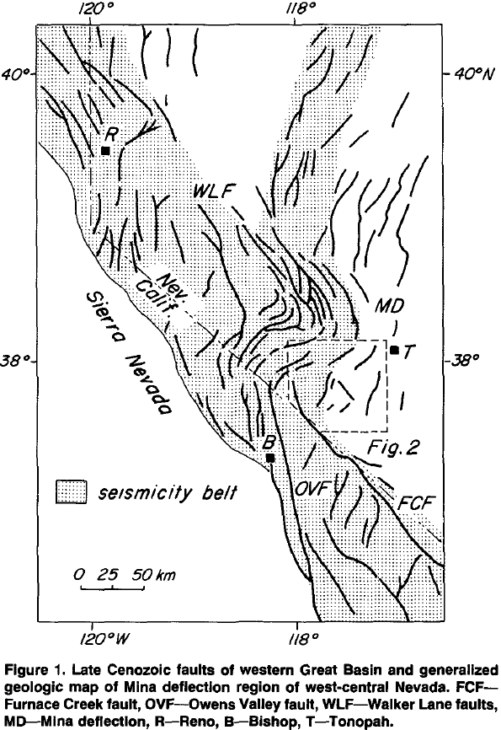
Owens Valley
~300km fault zone that has surface breaks in Quaternary deposits
Defined by north-northwest striking dip-slip and strike slip motion
This system only accommodates a few km of offset due to its youth ~3-5Ma
(Stewart, 1988)

Slide 5
Furnace Creek
~250km, northwest striking system from southeast California to western Nevada
Cumulative right slip of 40-50km
Activity began 12-8Ma
(Reheis & McKee, 1991; Oakes, 1987)
(Stewart, 1988; Reheis, 1992)

Slide 6
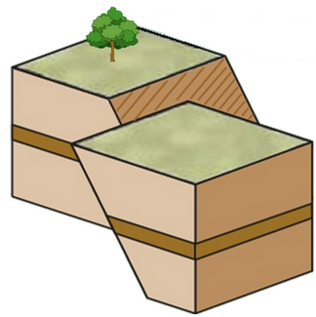
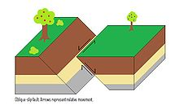
Mina Deflection
120km long, 75km wide belt of east-northeast late Cenozoic faults
These faults link faults of the central Walker Lane with those of the Furnace Creek and Owens Valley fault system
These curved high angle faults act as a displacement relay between the Owens Valley & Furnace Creek faults and the central Walker Lane transcurrent faults
Slip on these faults change from right oblique on north-northwest faults to left oblique on east-northeast faults
Chegg.com
Right Oblique
Left Oblique

Slide 7
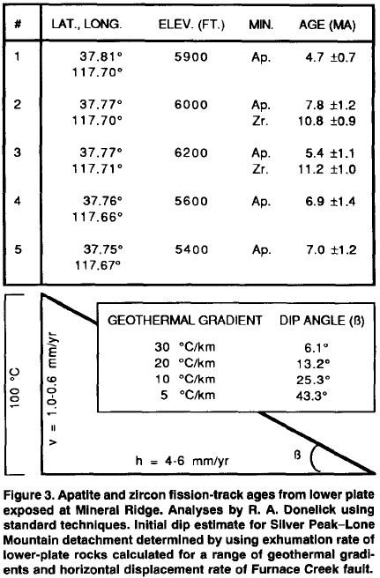
FIndings
“Given the 75km width of the Mina Deflection and estimates of basin depths, <10km of right lateral displacement can have been transferred between these systems” (Oldow, 1992)
Post late Miocene slip rates for northern and central Furnace Creek fault determined from offset plutons and layered rocks are 4-6mm/yr
Exhumation rates found to be 0.6-1mm/yr assuming geothermal gradients of 20°C/km for stable craton and 30°C/km for basin and range
Initial detachment dip of <15°
(Lachenbruch & Sass, 1978)
(Reheis & McKee, 1991)
(Oakes, 1987)

Slide 8
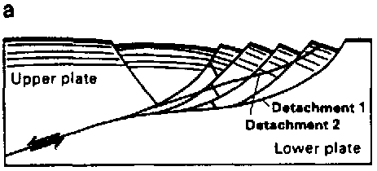
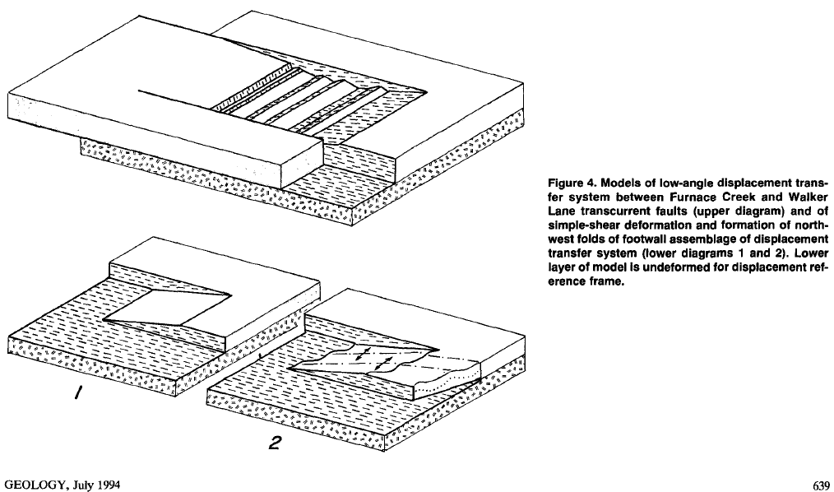
Proposed Model
Silver Peak-Lone Mountain detachment system transferred 30-40km of right slip from the Furnace Creek fault
Silver Peak-Lone Mountain detachment was a shallow northwest-dipping structure linking the Furnace Creek and Walker Lane fault systems
Steep faults in the upper plate merged with the shallowly dipping detachment fault and formed tilted blocks
Late Pliocene-Holocene high angle faults of the Mina deflection accommodate displacement transfer and may be the surface expression of a shallowly northwest dipping transfer system
(Lister, 1989)

Slide 9
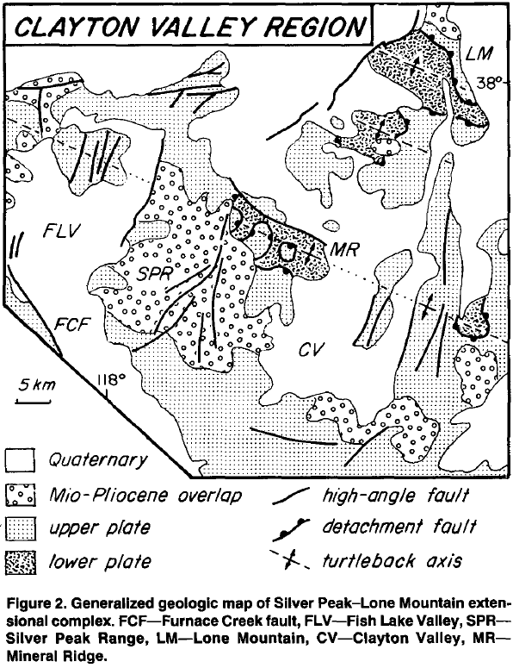
Conclusion
Take Home Point
30-40km deficit right slip from the Furnace Creek fault is accommodated by the Silver Peak-Lone Mountain detachment system

